Slide 1

Curbing US Corruption
Through the Budget Process
Scan QR Code for Model
Andrew Laing
26 August 2025

Slide 2

Overview
Background
  Research Questions
  The Equation
  Parameters
  Definitions
  A Key Risk Driver - US Budget Problems
Refinements
  Sectors (level of government)
  Functions (e.g. health and education)
  New Fiscal Space Scenario – 5% NATO
Summary of Main Findings

Slide 3
1. Background
2024 ECPR Conference Paper
  RQ1. Why is corruption not targeted through the annual budget process?
    Theoretical Answer : i) Sensitivity Issue in Government; and ii) Asymmetric Information
  RQ2. What are the losses and Where do they occur?
    Answer: Use the equation for a testable estimate of losses by various locations:
    i) public finance sub-system;
    ii) level of government; and
    iii) function of government
  RQ3. How can it be tackled through budget process?
    Working Answer: Presenting it as a source of fiscal space and resolve the sensitivity asymmetric information problem ….

Slide 4
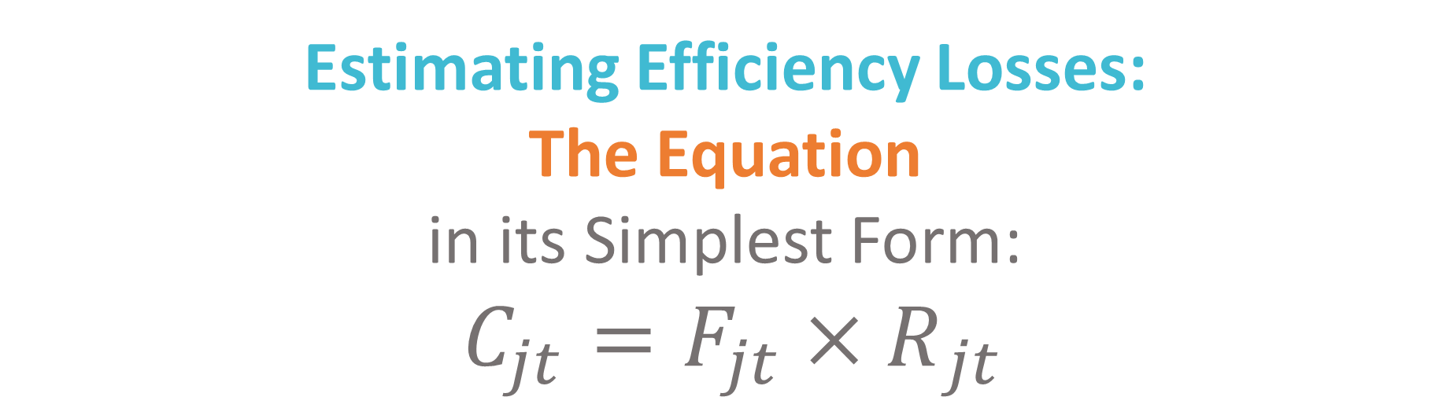
1. Background:
The Equation and the Semantic Model
Scan QR Code for Model
Estimating Efficiency Losses:
The Equation
in its Simplest Form:
$C_{jt}{={F_{jt}×R}_{jt}}$
$${Systemic Costs}_{ijt}{= {Financial Flows (GFS) }_{ijt}× {\{Risks\left(PEFA, CPI, OBI …\right)}_{ijt}×}{Impact (parameters)}_{ijt}\}$$
Subscripts i, j, and t denote country, period and subsystem
Also – government function and level
For more information see the paper
available on ECPR, DCU and AFI websites

Slide 5
1. Background: The Parameters
Category | Sub-System Impact Parameter (Raw) | Sub-System Impact Parameter (Adj) | Significance Factor | Systemic* Impact Parameters - Weighted | Base number Source
1 Budget | 1.000 | 0.600 | Assessed Importance | 0.083 | Total Expenditure
2 Treasury | 1.000 | 0.600 | % of non-centralized payments - proxy same as procurement | 0.083 | Total Expenditure
3 Procurement | 1.000 | 0.600 | % goods and services and non-financial asset acquisition (consolidated) compared to total consolidated expenditure | 0.083 | Total Expenditure
4 Contracts | 1.000 | 0.600 | Proxy: same as procurement | 0.083 | Total Expenditure
5 Verification and Payment | 1.000 | 0.600 | Assessed Importance | 0.083 | Total Expenditure
6 Audit | 1.000 | 0.600 | Assessed Importance | 0.074 | Total Expenditure
7 Payroll | 0.900 | 0.540 | % payroll compared to total expenditure | 0.083 | Total Expenditure
8 Accounting, Recoding and Reporting | 0.750 | 0.450 | Assessed Importance | 0.062 | Total Expenditure
9 Revenue
9.1 Revenue | 1.000 | 0.600 | % of Non-grant revenue compared to total revenue | 0.083 | Total Revenue
9.2 Grant Revenue | 0.750 | 0.600 | % of Grant revenue compared to total revenue | 0.083 | Total Revenue
10 Balance Sheet Management | 0.500 | 0.300 | Assessed Importance BS Adj | 0.041 | Total Assets and Liabilities
11 Accountability and Other Institutions
11.1 Anti-Corruption | 0.250 | 0.150 | Assessed Importance | 0.021 | Total Expenditure
11.2 Banking | 0.500 | 0.300 | Assessed Importance | 0.041 | Total Expenditure
11.3 Stats | 0.250 | 0.150 | Assessed Importance | 0.021 | Total Expenditure
11.4 Granting | 0.750 | 0.450 | % SNG grants comparted to total expenditure | 0.062 | Total Expenditure
11.5 Coms | 0.200 | 0.120 | Assessed Importance | 0.017 | Total Expenditure
Total | na | 7.26 | na | 1 | na

Slide 6
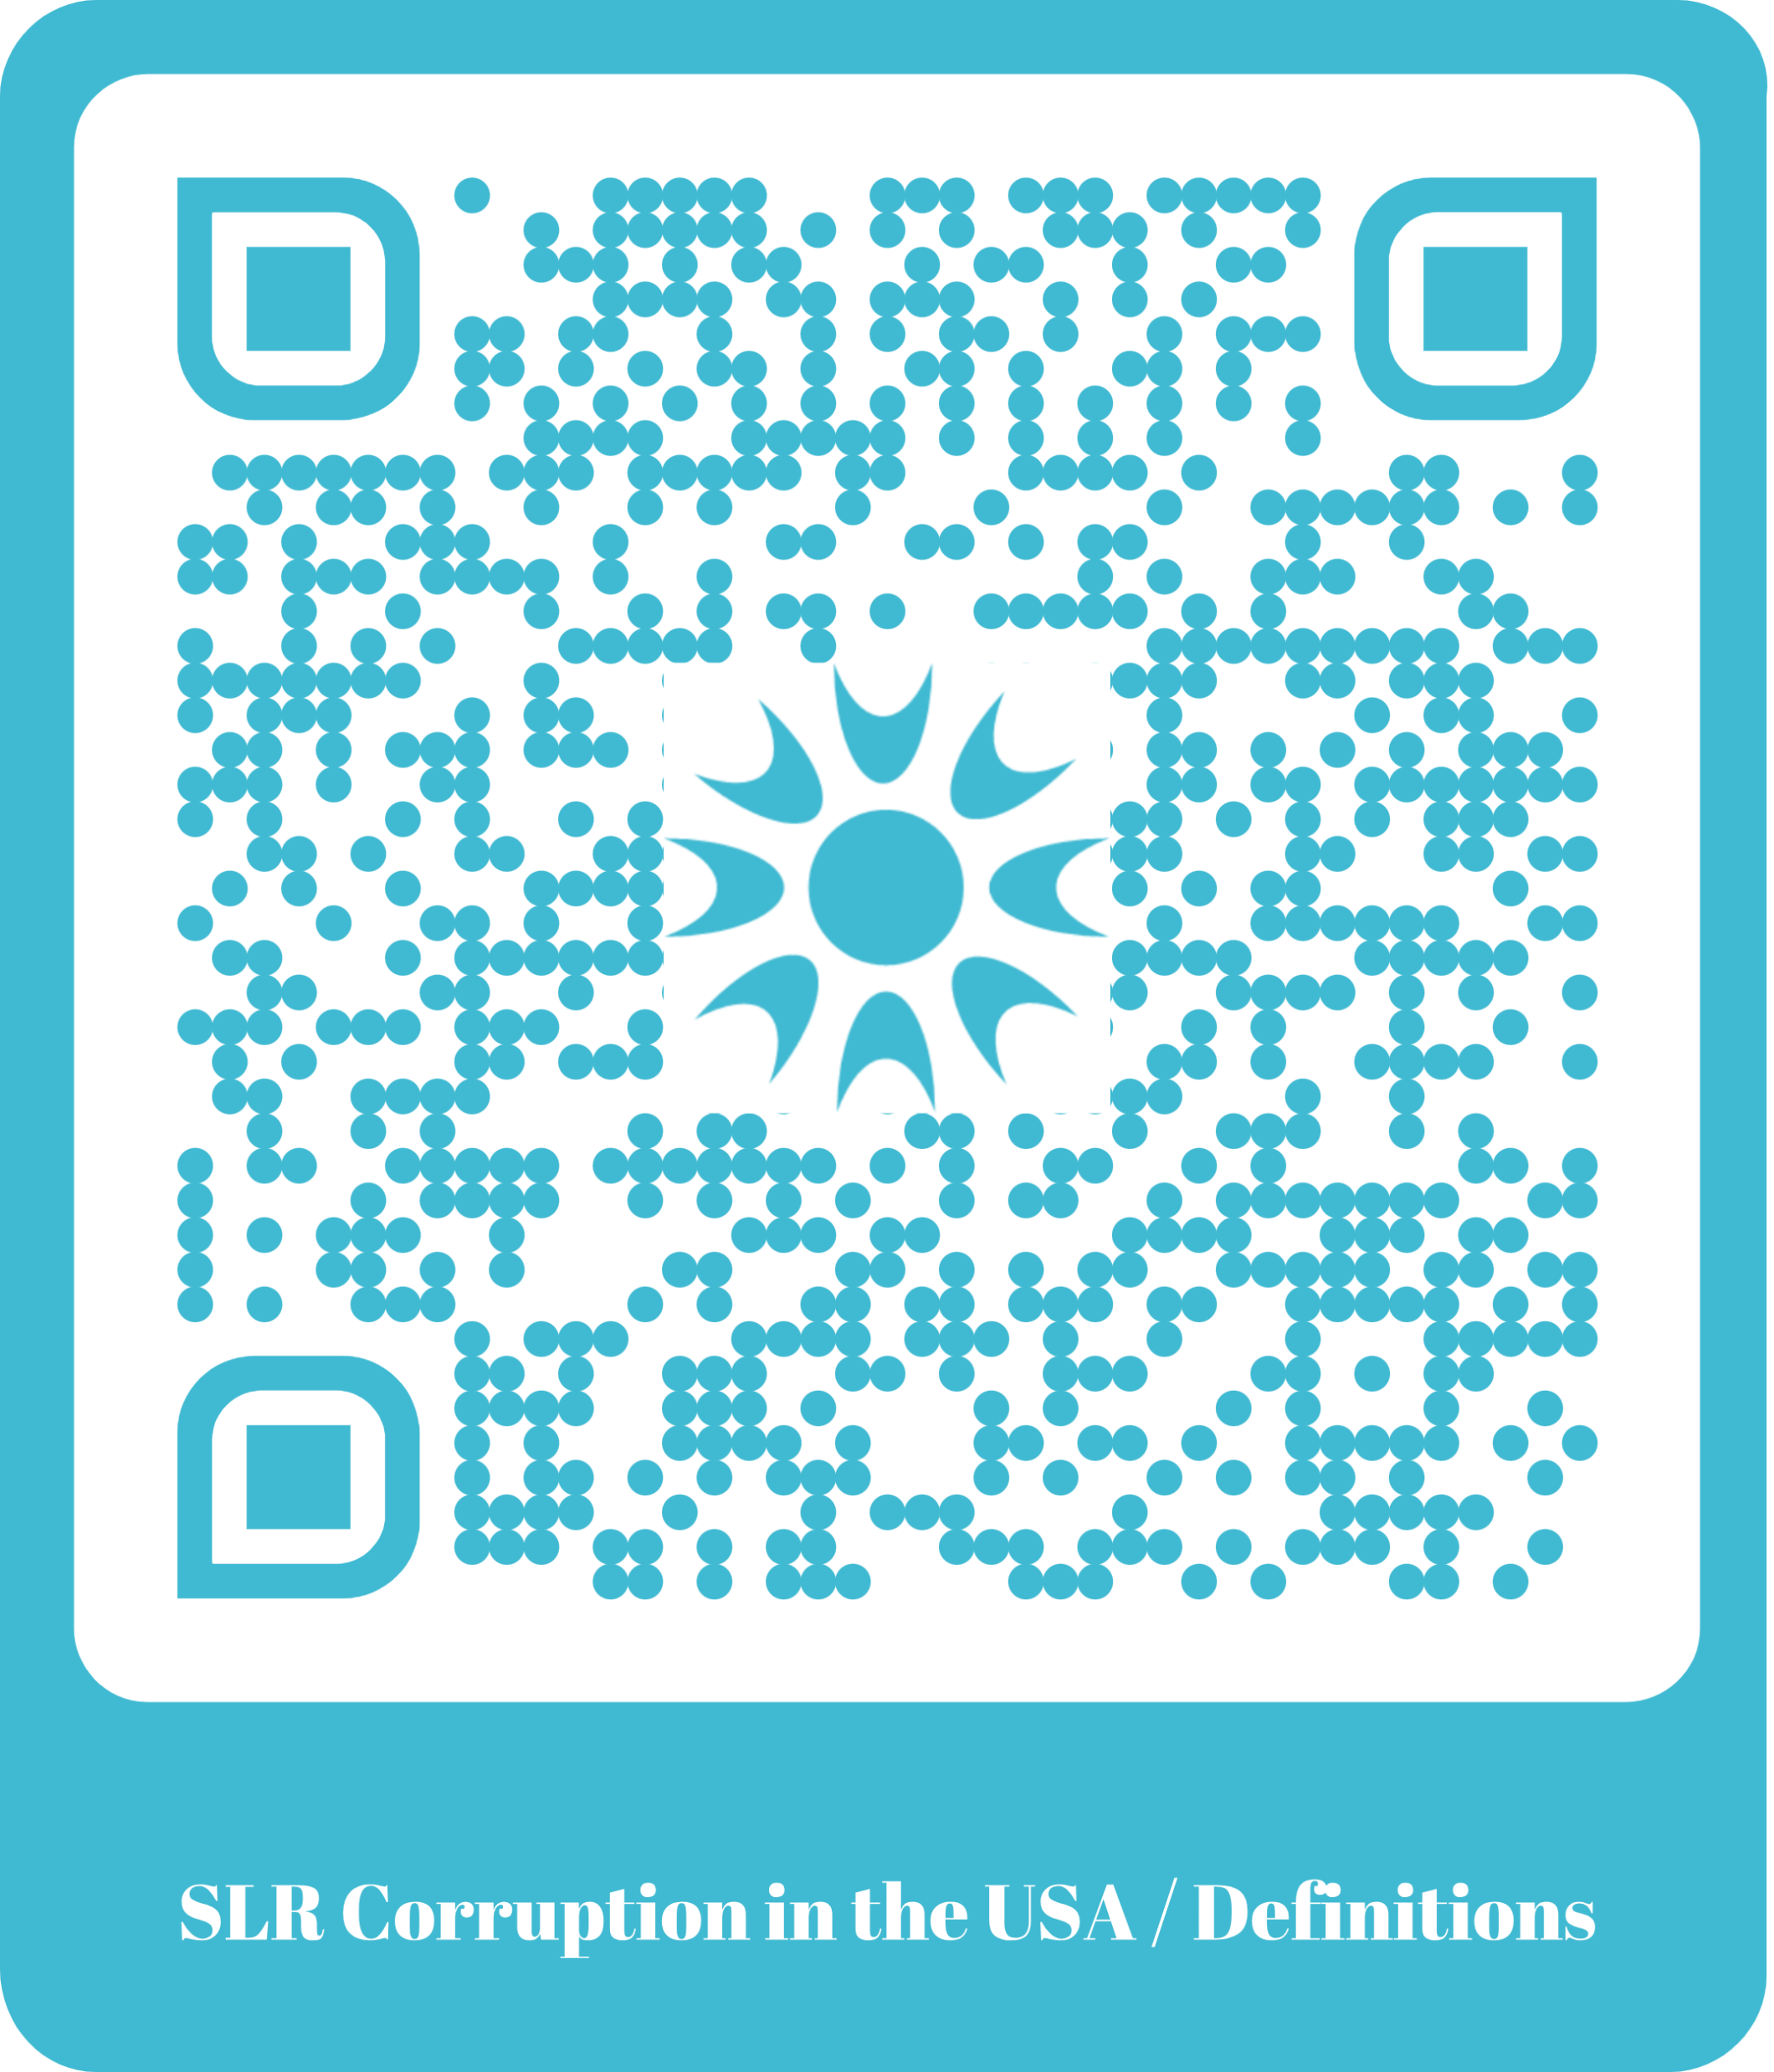
1. Background: The Definitions
For a Budget Process that Curbs Corruption
Political Manoeuvring: The use of power to gain or retain political, social, and/or economic outcomes in the public interest
Corruption: The abuse of power to gain or retain an advantage for oneself, someone else, and/or some other group (private interest)
Difference is Intent. Methods also important.
Power sources include: administrative, electoral, political, executive, judicial …
Power here is not limited to public power and can include: star, academic, professional body, lending, granting, monopoly …
Corruption as a form of Inefficiency (but not always)
  Other forms of inefficiency: incompetence, bad policy, good policy badly implemented
  Economic Inefficiency: allocative & distributive (political) and technical inefficiencies
Universal Challenge – Recognised by Adam Smith in 1759 and Keynes in 1936
Public Duty Values Clashing With Self-Interest Instincts
The SLR tool is available at: https://artificialfiscalintelligence.com/slr-corruption-usa-definition
Notes:
Understand the difference between Political Manoeuvring and Corruption
Corruption as a form of Inefficiency (but not always) – poor outcomes, increased risks, wrong policies, wrong people, and give away/lose too much …. (Red Flag Analysis)
Allocative and Distributive Efficiencies are strongly influenced by politics, especially in budgeting
Values V’s Instincts were both recognised by Adam Smith and Keynes
Smith in his 1759 book The Theory of Moral Sentiments discussed how humans have animalistic instincts like self preservation also have human traits like moral beliefs.
Keynes, introduced he term "animal spirits" in his 1936 book, The General Theory of Employment, Interest, and Money.

Slide 7
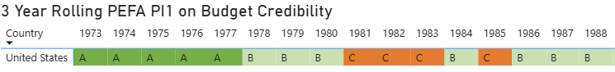
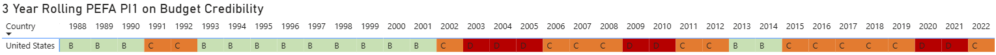
1. Background: Risks Drivers - Budget Problems
United States PEFA Grades
OPEC Oil Crisis/73-74 Recession Early 80’s Recession
Early 90’s Recession 9/11 2008 GFC COVID
Crisis, Corruption, or Political Maneuvering?
Reliability of Original US budgets collapsed at the turn of the century
An indicator of systemic corruption and/or expensive political maneuvering
Budget was exceptionally reliable in the 70’s and very good in the 80s & 90s
The Within-Year Package of Bills Problem – Scaling Up Budget Auctions and Expensive Political Manouvers within the Budget Process?

Slide 8
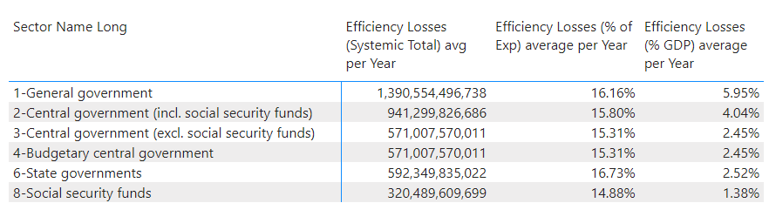
2.Refinements
Losses by Different Levels of the General Government Sector 2020-22
Source: Dublin City University Anticorruption Research Centre Academic Research (Laing)

Slide 9
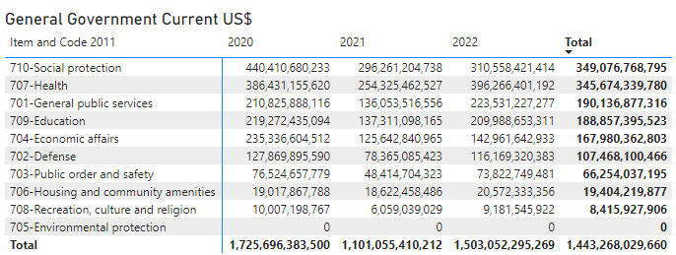
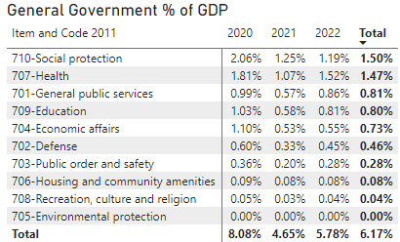
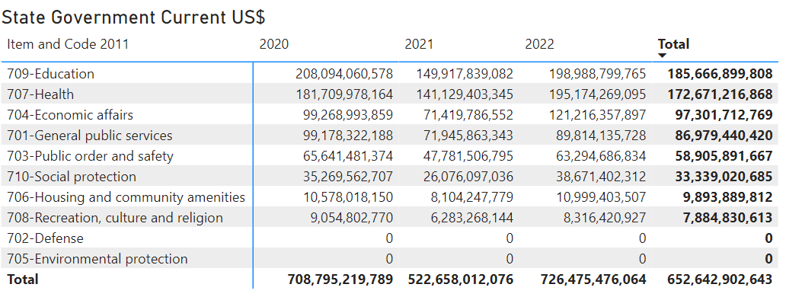
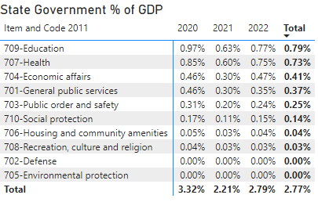
2.Refinements
Losses by COFOG - General Government Sector
Losses by COFOG - State Government Sector
Source: Dublin City University Anticorruption Research Centre Academic Research (Laing)

Slide 10
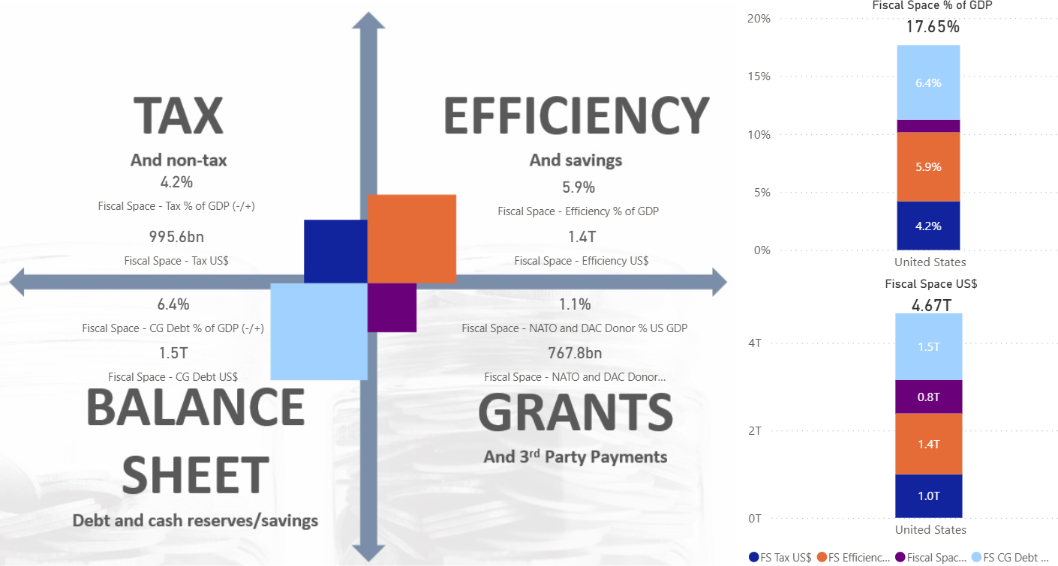
2. Refinements: USA’s Fiscal Space V4
Low Tax, Strong Borrowing, and High NATO Defense and Aid targets
Increase NATO target to 5% of GDP
Efficiency still remains the dominant source of fiscal space
  Tariffs may increase fiscal space
  3rd Party Payments still relatively small but NATO-based fiscal space dominates Aid
  Debt too high but can be use short term if other forms of fiscal space created and growth produced
Based on 2020-22 Data
General Government Sector
Source: Model Under Development at the Dublin City University Anticorruption Research Centre Academic Research (Laing)

Slide 11
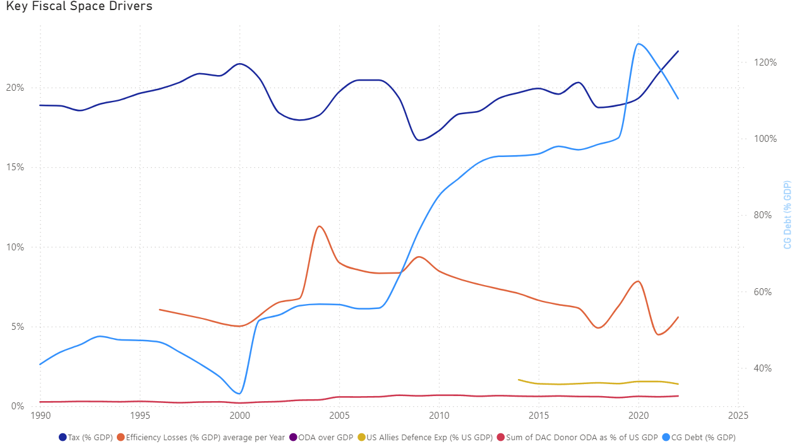
2. Refinements: USA’s Fiscal Space Drivers
Tax to GDP ratio stable and hovers around 20% +/- 3%
  FS Creation brings Tax to above 25% of GDP – reality c1/3 (c$300b from tariffs = 1.4% of GDP)
Debt to GDP has skyrocketed
  FS up by 6.4% with risks, but could fall
Inefficiency is a key source of fiscal space
  FS effects are ambiguous ($200b offset)
3rd Party Payments (NATO and AID) were relatively small but NATO policy change now significant
  FS doubles by 1.1% of GDP
+4.2%
+6.4%
Or -??
?
+1.1%
General Government Sector

Slide 12
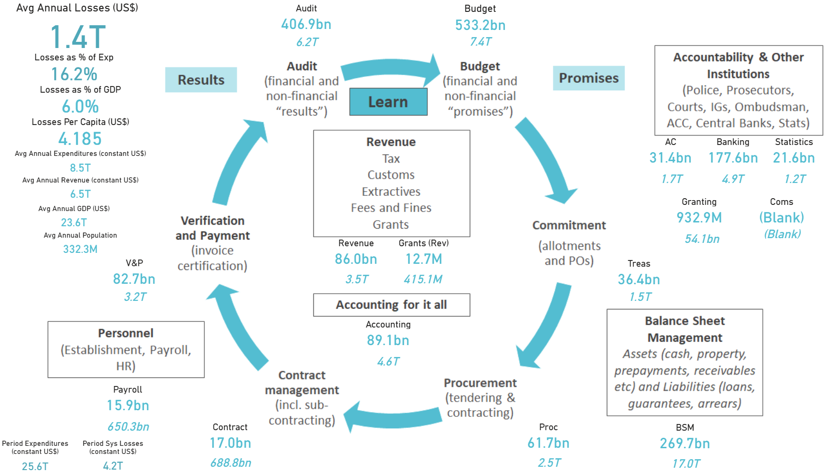
2. Refinements: Quantified Efficiency Losses
United States – General Government 2020-22
Source: Dublin City University Anticorruption Research Centre Academic Research (Laing)

Slide 13
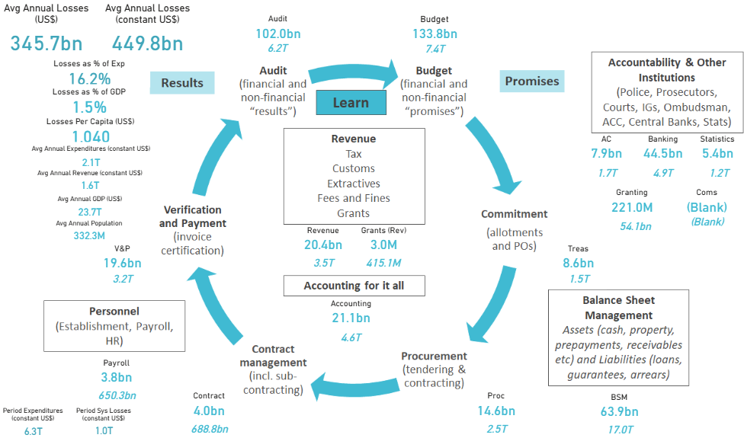
2.Refinements - Functions
General Government Health Function 2020-22
Source: Dublin City University Anticorruption Research Centre Academic Research (Laing)

Slide 14
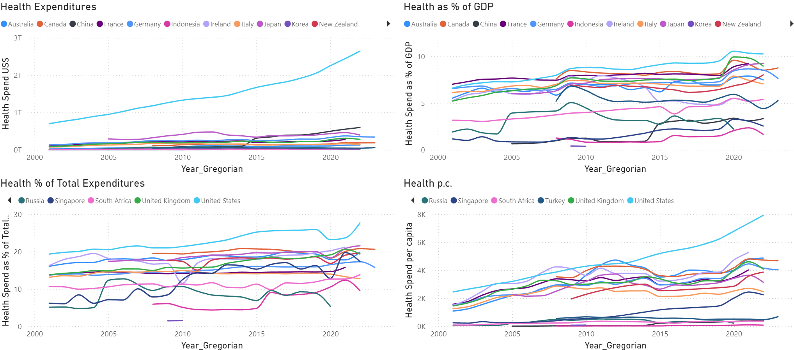
2.Refinements – Health Function
& Cost Benchmarks
General Government Sector – Country Comparators
US spends the most on health compared to all other countries in all four metrics historically
2022 Levels:
  $2.7 trillion
  10% of GDP,
  20% of total exp
  $8k per person
2nd Highest are Japan at 9% of GDP and Ireland $5kpp
Lowest is Indonesia at 1.5% of GDP

Slide 15
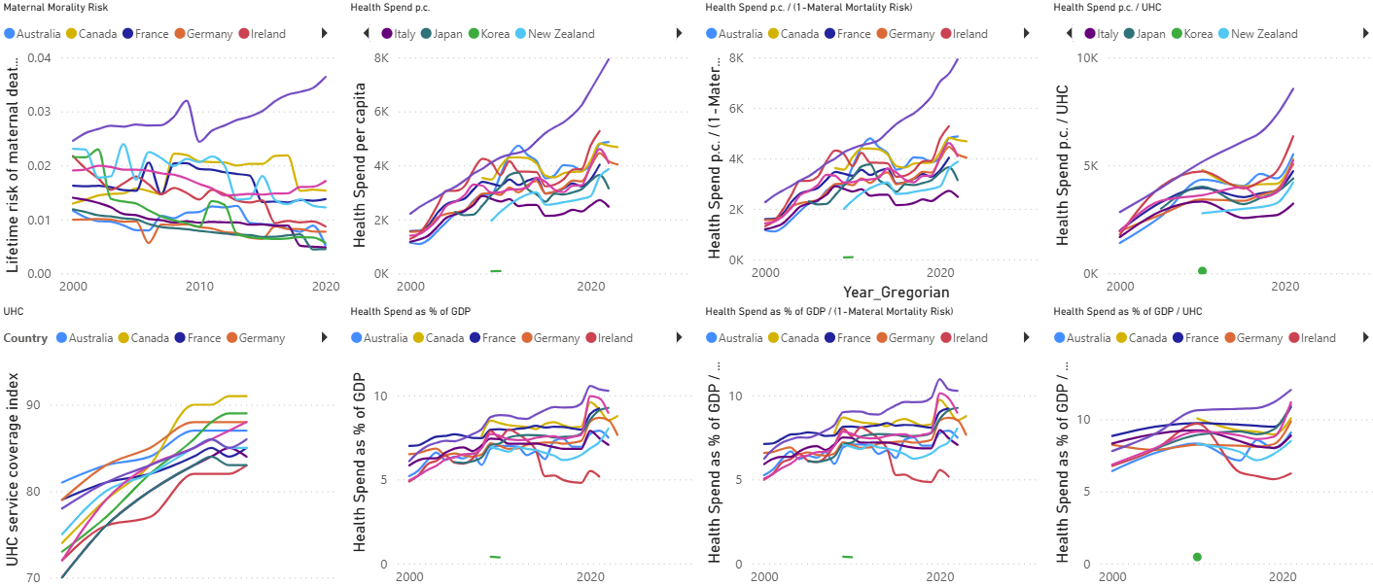
2.Refinements - Health Function
& Efficiency Benchmarks
Health – Maternal Mortality and Universal Health Coverage
Maternal Mortality risk and health funding positively associated
Universal Health Coverage (UHC) rates in the US are the most expensive in both per capita and % of GDP terms

Slide 16
3. Main Points
  Data issues: IMF GFS Database (Coherence and Granularity) and functional risks
  Government is Big and Messy - US is the Biggest and No Different
    Need to see corruption within context to everything else – incl. political maneuvering & other inefficiencies
    Public Data Based Estimates a Start (18 Tables / 166 Figures) – Gold Standard is using confidential data
  US Efficiency is Close to Being the Only Remaining Source of Fiscal Space
    But US taking some risks with expansion (Debt, Tax on International Trade & NATO) - Impacts yet to play out
    Lots of problems at functional levels over last two decades – Looked at health only here
    $1.4 tr in efficiency opportunities at the GG Level
    Politics of Efficiency – Allocative Efficiency >> Programs Change for Different Priority Impacts but Policy can be used as Cover for Patronage
  Fiscal Space and Efficiency Assessment Can be Done for Any Country Relatively Quickly
  More Research Needed

Slide 17
Thank You

